Slide 1


OFFICE 365
TIPS & TRICKS FOR BEAUTIFUL POWERAPPS
Alon Kaduri
Digital Workspace Expert
alon@kaduris.com

Slide 2
Agenda
PowerApps Design Pyramid
Tips and Trick
Demos
Tools &Learning Resources

Slide 3
PowerApps Pyramid – Your Framework for Design
Branding
User Experience
Performance

Slide 4
The Importance of Performance

Slide 5
PowerApps Loading Process
Authentication
Metadata Retrieval
(Data Sources, Version)
Run OnStart Code
Render Screens

Slide 6
Performance Tips
Cache Data When Possible
Load data simultaneously
Don’t repeat the same formula

Slide 7

Demo - Performance
Collections
Concurrent Function
Re-use formulas

Slide 8

What is User Experience
Easy to Use
Accessible
Efficient
Effective
Engaging

Slide 9
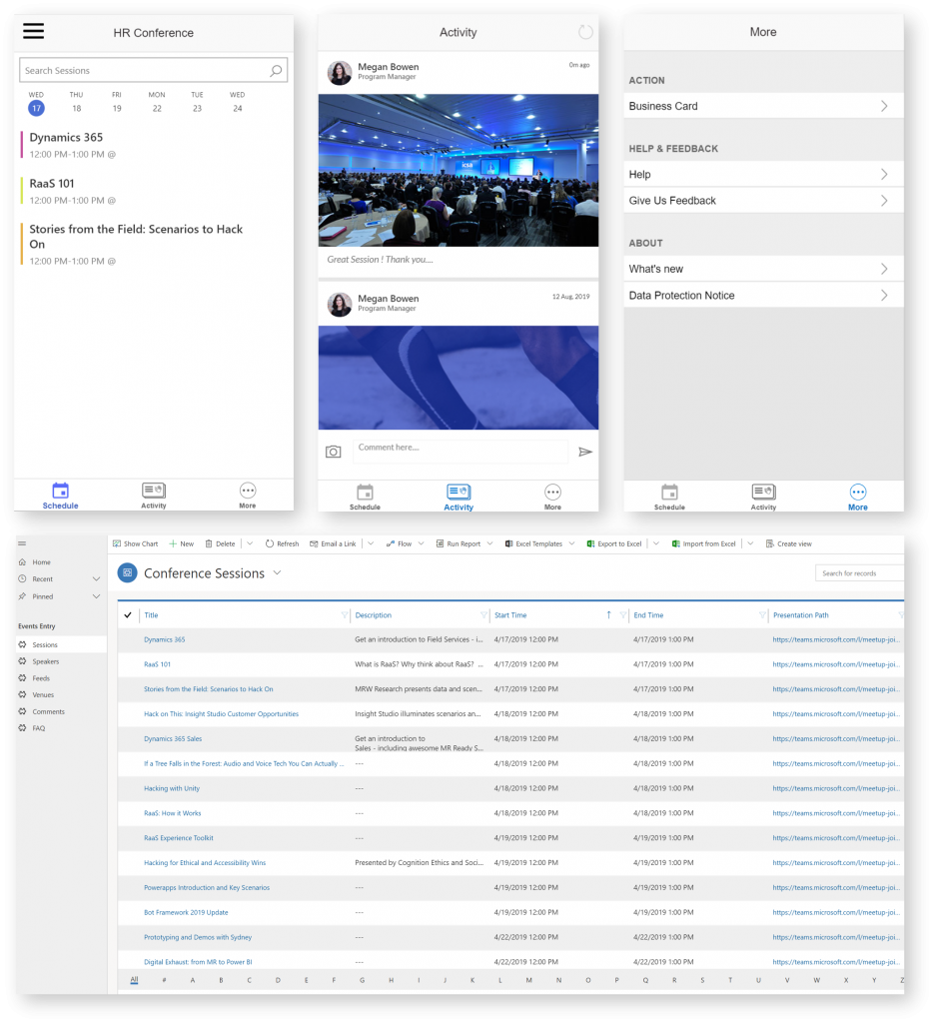
Tip 1 – Get Inspired
Microsoft PowerApps Templates
Customer Success
Asset Checkout
Suggestion Box
Microsoft Employee Experience Starter Kit
UIMovement.com
#PowerAddicts

Slide 10
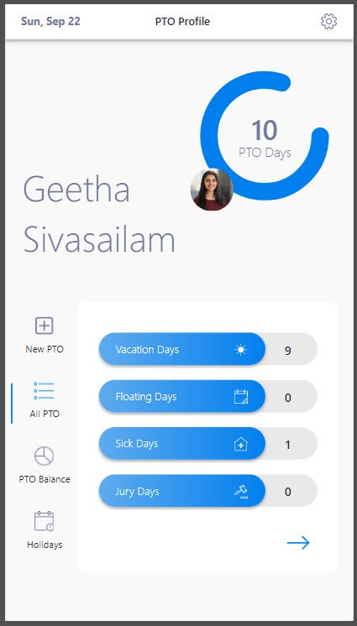
Tip 2 – Use the HTML Control
Gives you more flexibility
Box shadows
Text shadows
Gradients
Add CSS to your text
HTML/CSS Generator Tools:
Html-online.com
Html-css-js.com

Slide 11
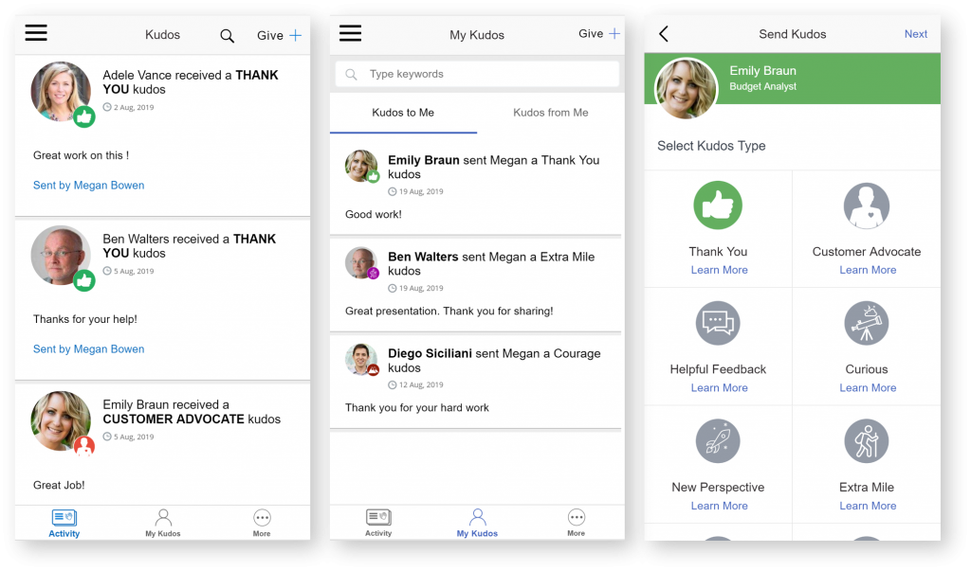
Tip 3 – Reduce Clutter
Clutter is the enemy of good design!
Tabs to reduce scrolling
Flyout Menus
Visuals in place of text
Components for reusability

Slide 12

Demo - UX
Loading & Success
Tabs
Dialog boxes
Html control
Components

Slide 13
UX Tips
Keep User Informed with Loading and Success Messages
Clutter is the enemy of good design!
Choose Visuals over Text. A picture’s worth 1000 words
Be mindful of accessibility
Leverage Native Device Functionality

Slide 14
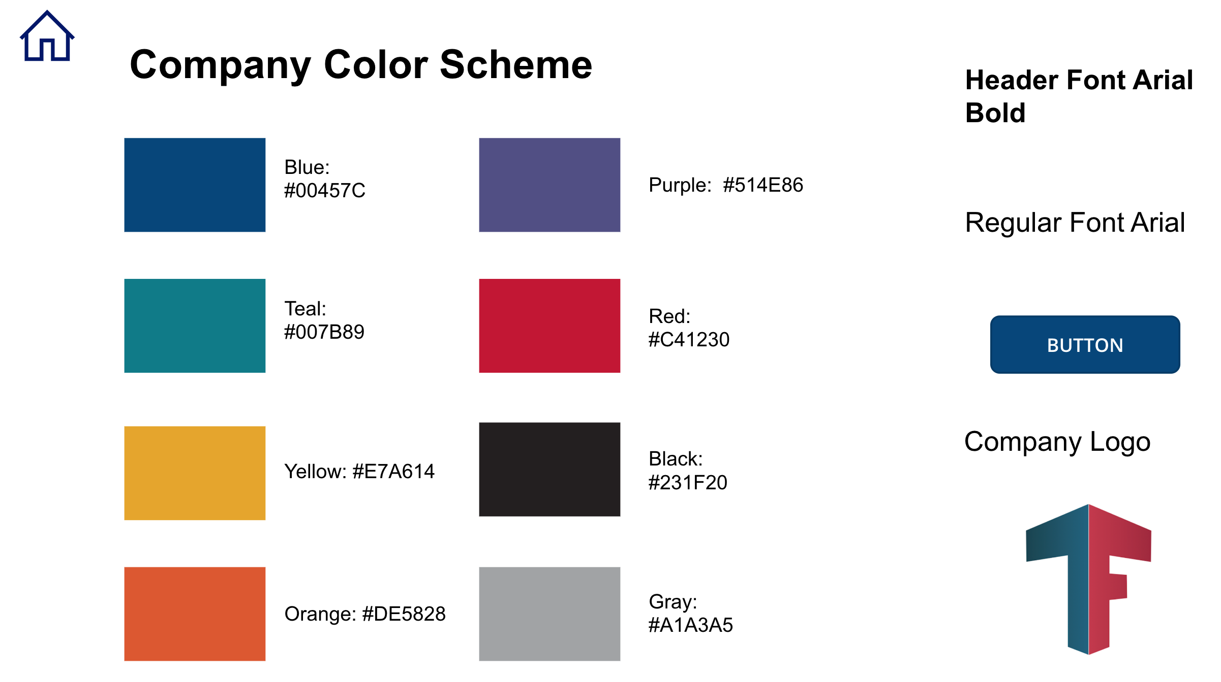
What is Branding
Color Scheme
Typography
Images

Slide 15
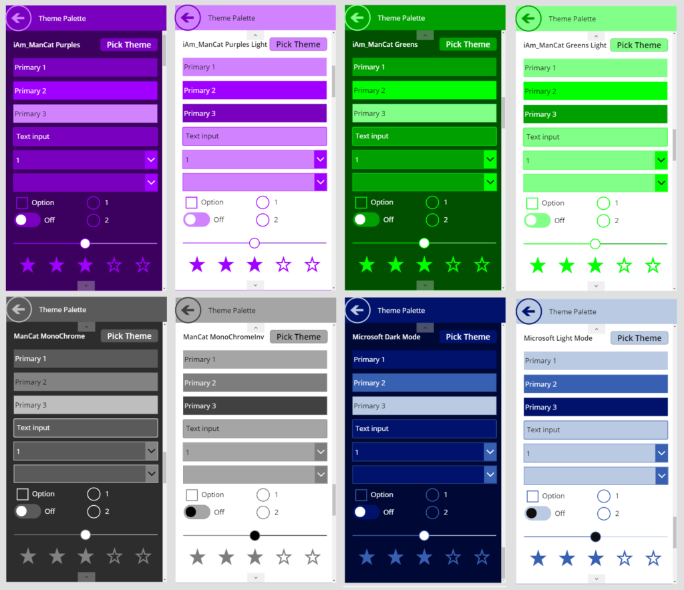
What is Branding
Color Scheme
Typography
Images

Slide 16
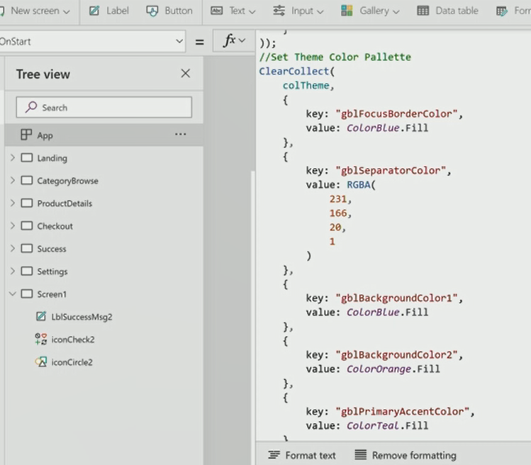
What is Branding – how to?

Slide 17
Branding Tips
Use company brand standard
Create a branding screen
Create a Custom Theme
Optimize Images

Slide 18
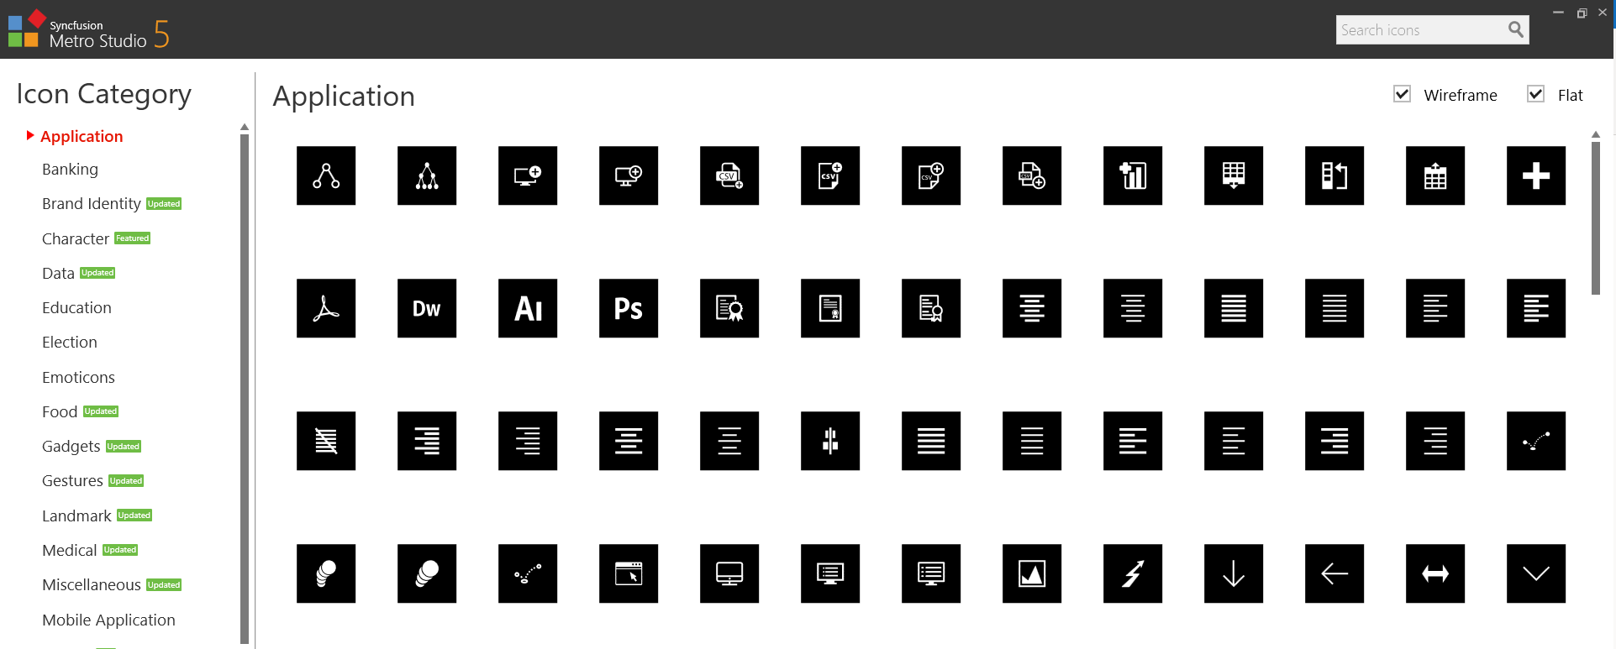
Tools - Syncfusion – Metro Studio

Slide 19
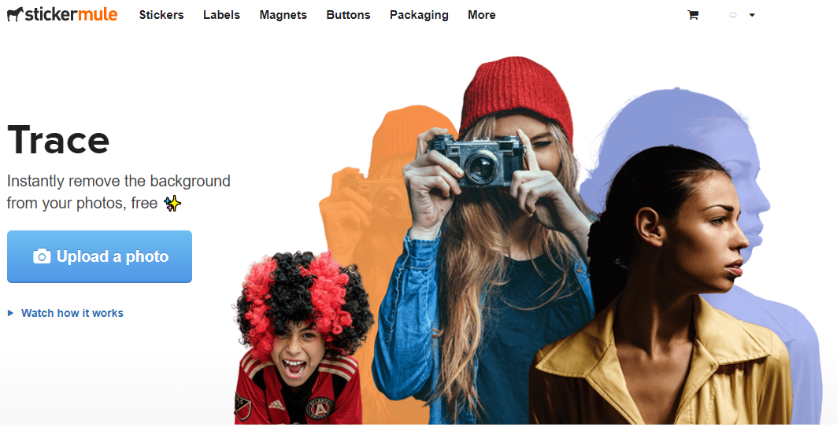
Tools - https://www.stickermule.com/trace

Slide 20
Additional Resources
PowerApps Optimization Microsoft Blog: https://bit.ly/2MucwWE
Component Examples: https://bit.ly/33s5iJU
Free GIFS & SVGS: https://loading.io
Image Compressor: https://compressor.io/
Design Inspiration: https://uimovement.com
Shaen Young, Audrey Gordon’s YouTube Channel - https://bit.ly/2rbpf9R
#PowerAddicts, @GSiVed, @YusufShariff, @AlanChai

Slide 21
Summary
Large connected data? - use collections & concurrent.
Re-use formulas
Reduce the clutter – Tabs, dialogs.
Prefer images over text / think of the user (experience)
Use components for time saving & simplicity

Slide 22
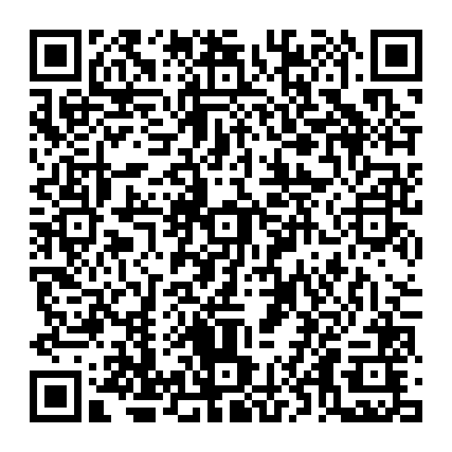
Thank You!
Alon kaduri
alon@kaduris.com
054-5886970

Slide 23

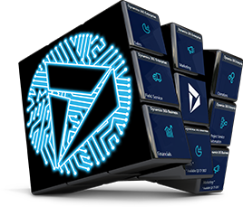



Slide 24
365 Saturday Agenda Format
Time | Room 1 - Reactor
09:00 - 10:00 | Key Note - Oren Ryngler
10:10 - 11:10 | The evolution of CRM systems in the digital era – Shai Enat
11:15 - 12:15 | Microsoft Dynamics 365 - Sales Insight - Natalie Niculescu
13:00 - 14:00 | Microsoft Dynamics 365 - Azure Integration Patterns - Yaniv Arditi
14:05 - 15:05 | Connecting the IoT world with PowerApps custom connectors – Victor Dantas
15:10 - 16:10 | Power Platform : AI App Builder and Platform overview for the XRM Developers - Victor Dantas

Slide 25
365 Saturday Agenda Format
Time | Room 2- Reactor
09:00 - 10:00 | Key Note - Oren Ryngler
10:10 - 11:10 | Heathrow PowerApps Framework - Samit Saini
11:15 - 12:15 | PowerApps Portals Deep Dive - Victor Dantas
13:00 - 14:00 | What's new in Power Platform 2019 Wave 2? - Aric Levin
14:05 - 15:05 | Power Platform Governance - Heathrow user case - Samit Saini
15:10 - 16:10 | PowerApps Component Framework Control Development - Aric Levin

Slide 26


Dynamics 365 Community
Join the Dynamics 365 Community, where you can interact with your peers and Microsoft Dynamics 365 experts. You can get answers to your questions by posting questions in the forums, starting discussions, reading informative blog articles, and watching how-to videos.
https://community.dynamics.com
Benefits
Participate and help build a pool of knowledge that’s accessible by members at any time!
Expand your network by engaging with peers
Involvement
Need help? Ask questions and join in on business or technical discussions in the forums
Share your expertise by hosting a blog or syndicating your existing blog
Recognition
Earn badges for participation and engagement
Become a Community Star and earn appreciation from peers
Join Today!
Get answers, find inspiration, connect with others
Free membership
Any questions? Email us at dlcommed@Microsoft.com

Slide 27

Social
www.365portal.org
Twitter: @Dyn365Community
Linkedin: @365-Saturday
Hashtags
#DynamicsPowerTelAviv #msdyn365
Wifi: TBC
Pass: TBC
Community.Dynamics365.com

Slide 28
Feedback
We really value your feedback. Log-in to the 365portal event page and click on the session title.
Make sure you have added the session to your schedule and you have checked in.
You can now leave feedback which will help the speaker and improve our future events for the community.

Slide 29
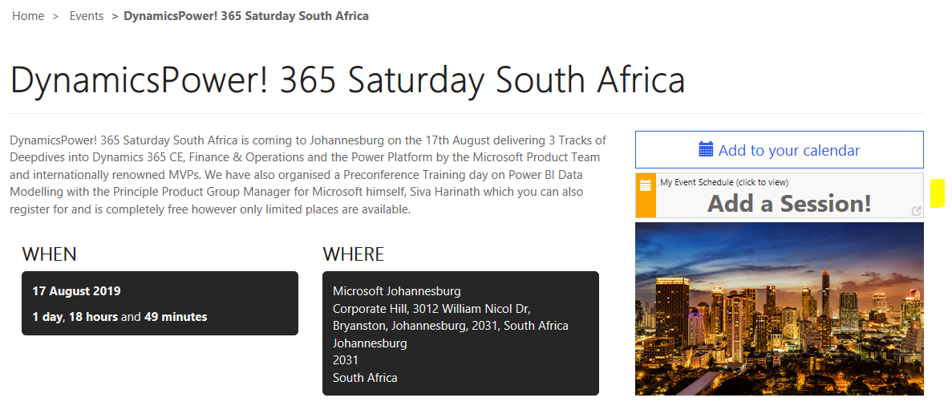
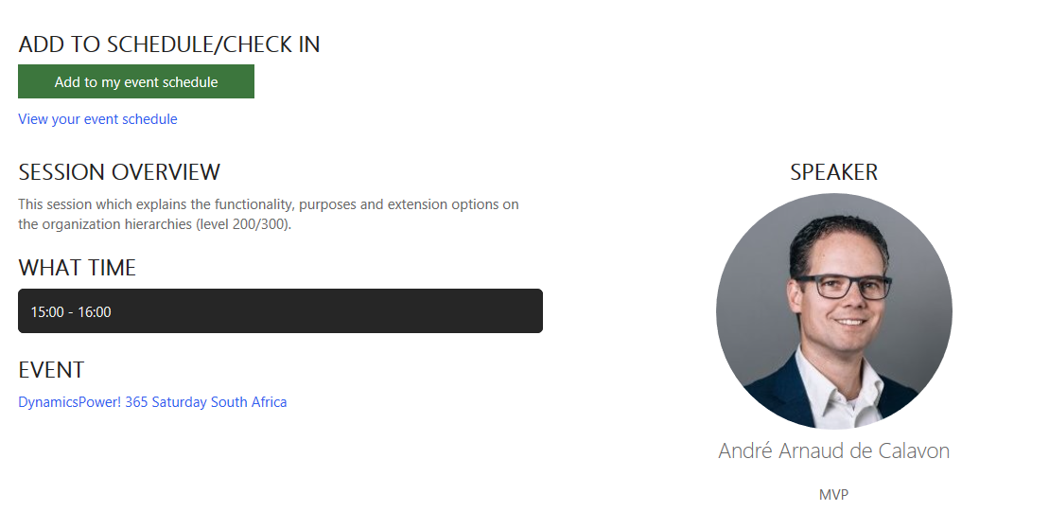
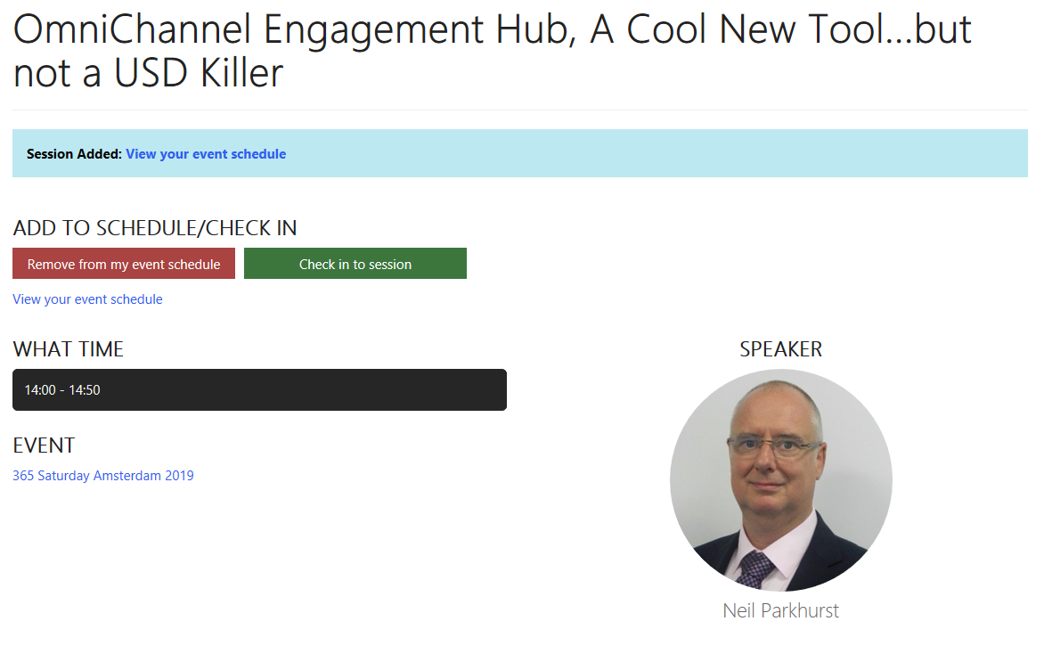
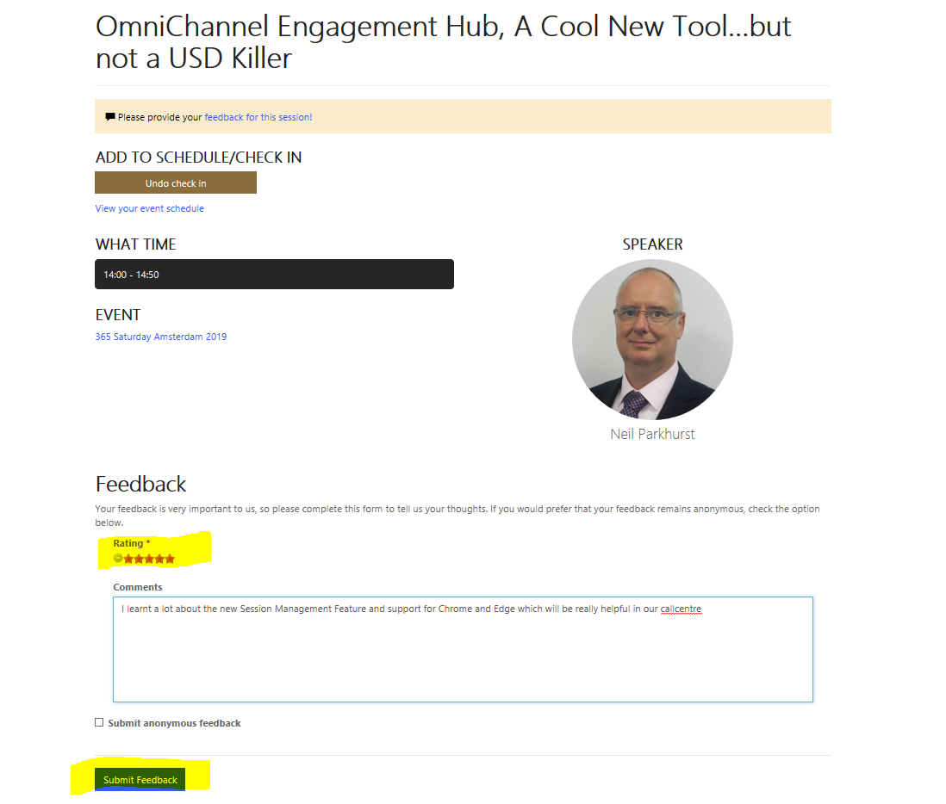
Feedback

